Slide 1
Project Reminder
Matthew Soto

Slide 2
Purpose
Make life easier.
Store important info and have easy access to it.

Slide 3
Demographic
Young & Old Adults
Teenagers
Elderly

Slide 4
Materials
Hard, bendable plastic
Arduino
Cell Phone
Blue Tooth
SD Card Shield (Preferable mini)
Screen Display
PSP 2 axis analog thumb joystick

Slide 5
How it will work
The user will send a text to the device. The device then will store the text and by using the joystick view other saved messages.
(PLAN B) The user can type in a message on the computer. That message is then stored on the device.

Slide 6
Frequently asked Questions
Q. What the Power Supply will be like.
A. N/A
Q. How to make the device wearable and comfortable?
A. Use bendable plastic and small components.
Q. Will there be indicators?
A. No, but it is a possibility.
Q. Where will it be used?
A. The device can be used both inside and outside.

Slide 7
Things to take into consideration to appease users
Fonts to make text readable
Screen type
Navigation
Style
Interfaces

Slide 8
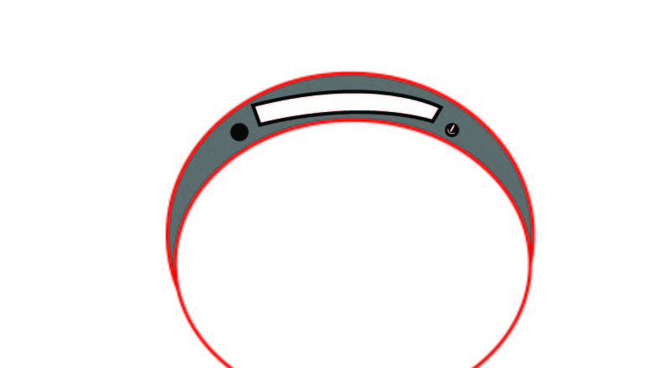
Design Prototype

